Slide 1
Safety -
refers to the safety concerns associated with active metals in electrochemical technologies. Active metals, such as lithium, have a propensity to react vigorously with water and air. For instance, lithium can catch fire or even explode upon contact with water. These reactions pose significant safety risks, especially in the handling, storage, and transportation of active metals.
To mitigate these risks, it is essential to develop and implement safe protocols and containment methods.

Slide 3
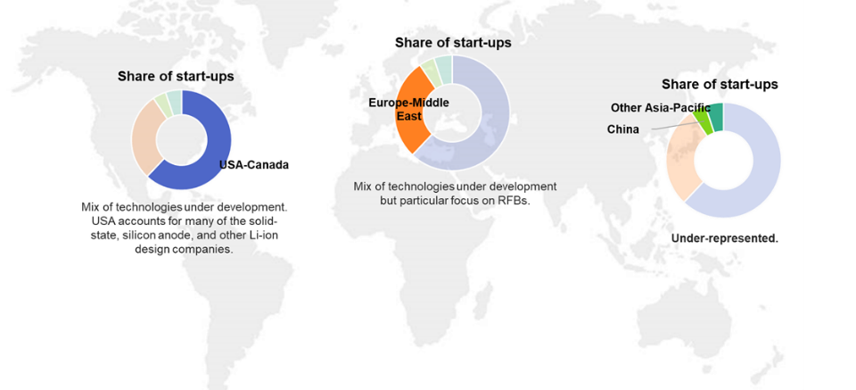
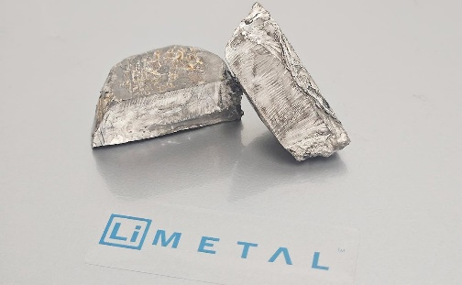
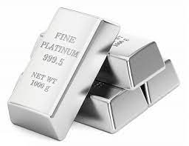
Cost and Availability -
highlights the economic challenges related to the cost and availability of active metals in electrochemical technologies. Certain active metals, like lithium, are relatively expensive to extract, refine, and produce. Moreover, their availability might be limited due to geographical constraints, geopolitical factors, or supply chain disruptions.

Slide 4
Pt usage in electrochemical process

Slide 5
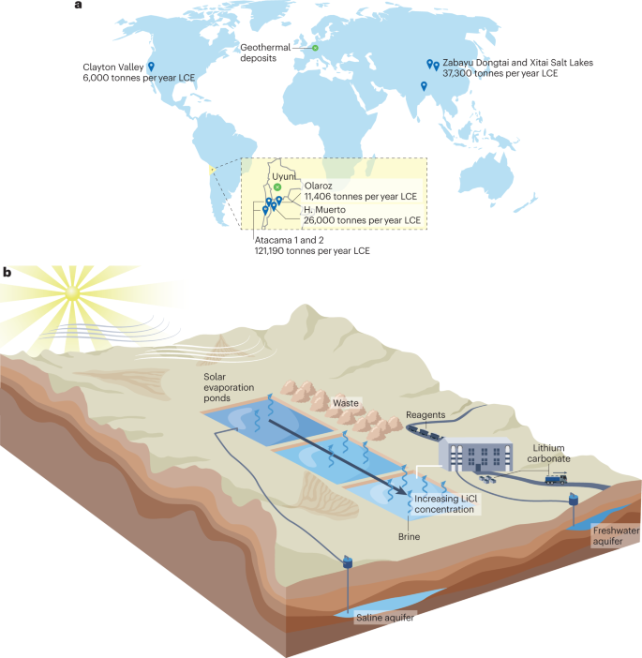
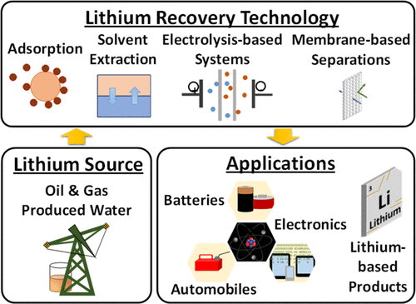
Li salts production for energy storage systems

Slide 6
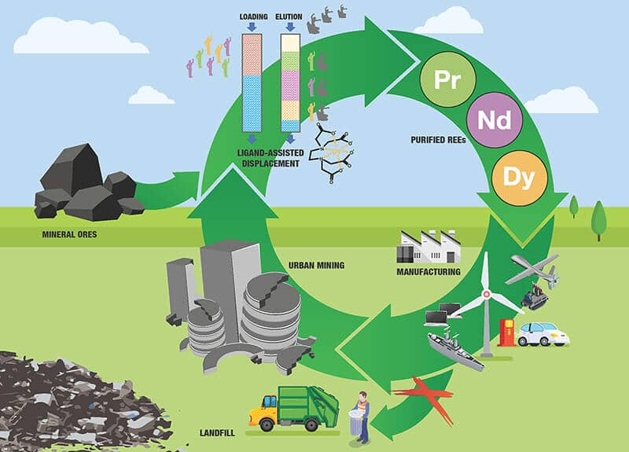
Environmental Aspects
refers to the environmental aspects associated with the use of active metals in electrochemical technologies. Improper disposal, leakage, or accidental release of active metals and their by-products can lead to pollution and environmental contamination. This pollution can affect soil, water bodies, and wildlife, posing risks to ecosystems and human health.

Slide 7
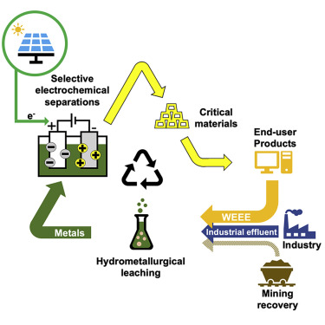
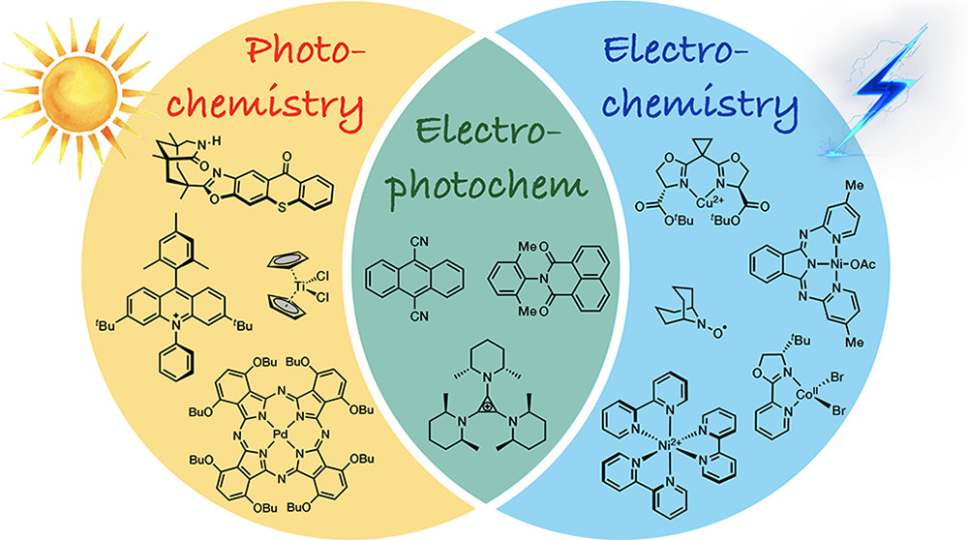
Environmental waste in electrochemical industry

